Slide 1
Mini siri
Your Smart Assistant

Slide 2
The General Idea & how it works
Mini Siri
2

Slide 3
The General idea
- Mini-Siri is a virtual assistant, The general idea behind Mini-Siri is to provide users with a voice-activated interface to interact with their devices using natural language.
- Mini-Siri is designed to perform various tasks and answer questions, acting as a personal assistant that can help users with a wide range of functions.
- Mini-Siri uses advanced natural language processing and machine learning technologies to understand and interpret user commands, making it capable of handling a variety of tasks.
3
Mini Siri

Slide 4
Our Target from the idea
Mini Siri
4

Slide 5
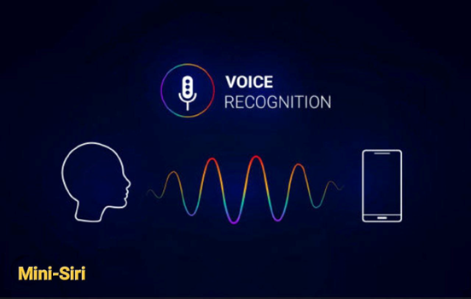
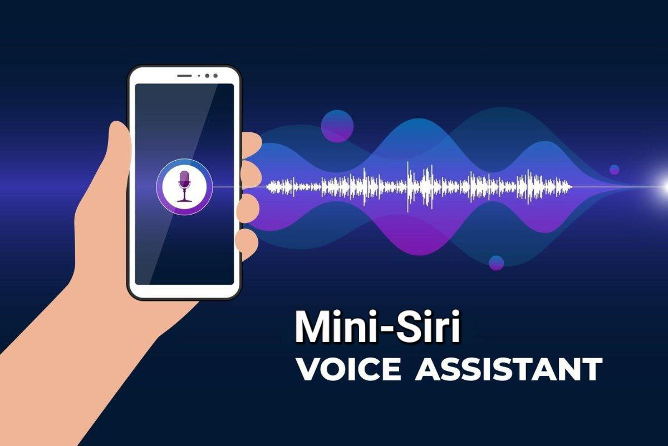
The target from mini-siri :
It provide users with a convenient and efficient way to interact with technology and perform various tasks. The primary objectives of Mini-Siri are:
- Increase Efficiency :
The goal is to help users save time and effort by automating routine tasks. Mini-Siri can perform a variety of functions, such as opening apps, search and providing information, more quickly than traditional methods.
- Improve Accessibility:
Mini-Siri play a crucial role in enhancing accessibility for individuals with disabilities. Voice-activated interfaces, it can be particularly valuable for people with mobility issues or those who may have difficulty using traditional input methods.
Mini Siri
5

Slide 6
The target from mini-siri :
- Provide Information and Assistance:
Mini-Siri are designed to offer information and assistance across a wide range of topics. Users can ask questions, get weather updates, receive news briefings, and more, contributing to a more informed and connected user experience.
- Facilitate Hands-Free Operation:
Mini-Siri enable hands-free operation, allowing users to perform tasks while driving, cooking, or engaging in other activities where hands may be occupied.
By achieving these goals, Mini-Siri aim to create a more user-centric and intuitive interaction between individuals and their devices, ultimately enhancing the overall user experience.
6
Mini Siri

Slide 7
How it works ?!
Mini Siri
7

Slide 8
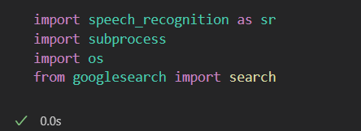
Mini Siri
How does mini-siri work ?
Mini-Siri work through a combination of natural language processing (NLP) and machine learning algorithms, Here's a general overview
of how Mini-Siri function:
1- Importing Required Libraries :
First, create a new Python file and import the required libraries:
8

Slide 9
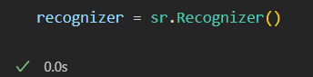
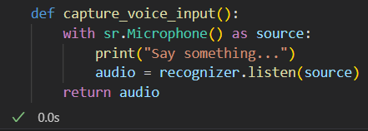
How does mini-siri work ?
3- Creating a Recognizer Instance :
Create an instance of the Recognizer class:
4- Capturing Voice Input :
Create a function to capture
voice input from the user using a microphone:
Mini Siri
9

Slide 10
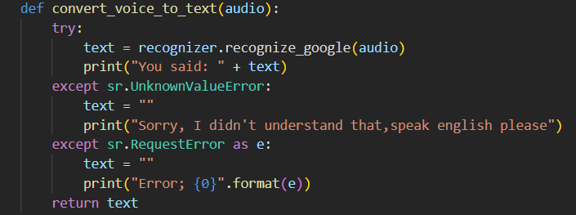
How does mini-siri work ?
Mini Siri
5- Converting Voice Input to Text :
Create a function to convert the captured voice input to text:
10

Slide 11
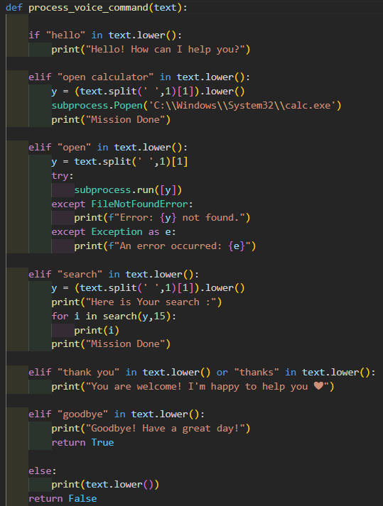
How does mini-siri work ?
6- Processing Voice Commands:
Create a function to process the voice commands:
Mini Siri
11

Slide 12
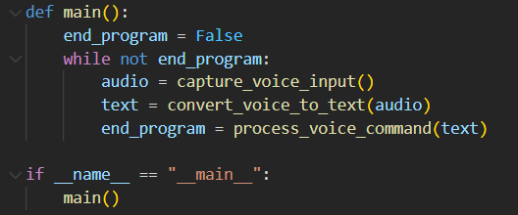
How does mini-siri work ?
Mini Siri
7- Putting It All Together:
Create a main function to run the voice recognition system:
12

Slide 13
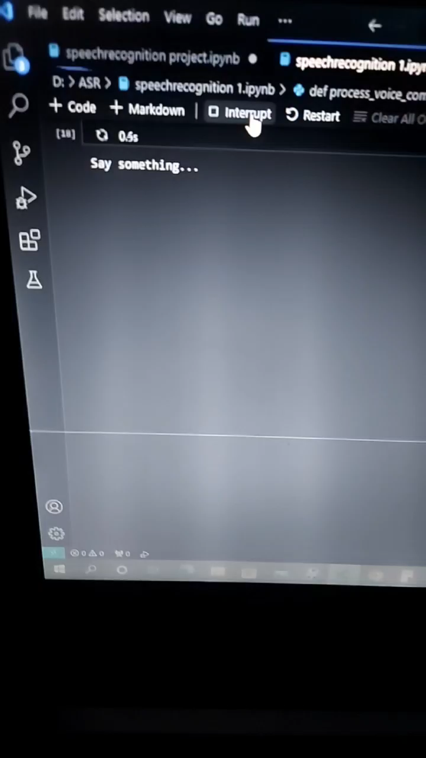
How does mini-siri work ?
Mini Siri
13

Slide 14
Future aspirations
Mini Siri
14

Slide 15
Future aspirations
for mini-siri :
- Learning and Adaptation:
To continuously learn from user interactions to improve their performance over time. it adapt to user preferences over time, refine language understanding, and update their knowledge base based on new information, it improves the accuracy of responses.
- Translation :
Translating phrases or sentences into different languages.
- Mathematics and Conversions:
Performing calculations.
Converting units of measurement.
3
Mini Siri

Slide 16
Future aspirations
for mini-siri :
- Support Multimodal Interaction:
It will be capable of handling multimodal interactions, combining voice, text, and touch inputs. This flexibility allows users to choose the most convenient and effective method for a given situation.
- Health and Fitness:
Providing health and fitness-related information.
Setting health-related reminders.
- Device Integration:
Personal assistants are integrated into various devices and ecosystems. Allowing seamless communication and coordination between different devices.
3
Mini Siri

Slide 17
THANK YOU ❤️
Mini Siri Team
Samer Wael – Ahmed Sameh
We hope that you liked Mini-Siri & It’s Presentation ✨
We look forward to you providing us with some advice so that we can develop the project ❤️
Mini Siri

